Slide 1
CPAP Machine

Slide 2
Requirements for CPAP
Oxygen FiO2 21 to 100%
Pressure CPAP 4 to 7 cms
Flow 2 to 7 liter/min
Temperature 37ºC
Humidity 100% RH

Slide 3
Requirements for CPAP
Oxygen Compressed Air
      Compressed Oxygen
      Blender
Pressure Flow of gas and CPAP Generator
Temperature
Humidity
Humidifier

Slide 4
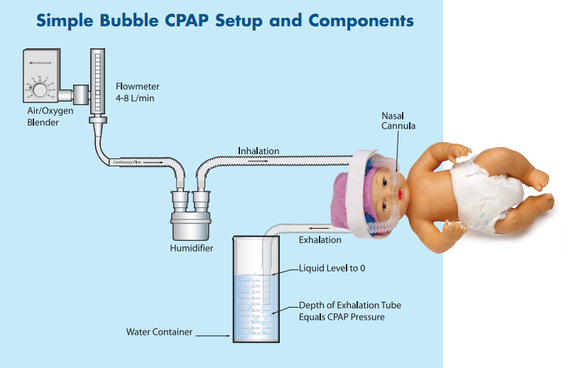

Slide 5
CPAP Generator
Circuit
4cm
Obstruction
Air Oxygen mixture
Patient interface
Depth of immersion- 4cm
4cm
Patient lungs

Slide 6
Oxygen
Compressed
Air
Blender
50%
Compressed
Oxygen
21%
100%
Flow meter

Slide 7
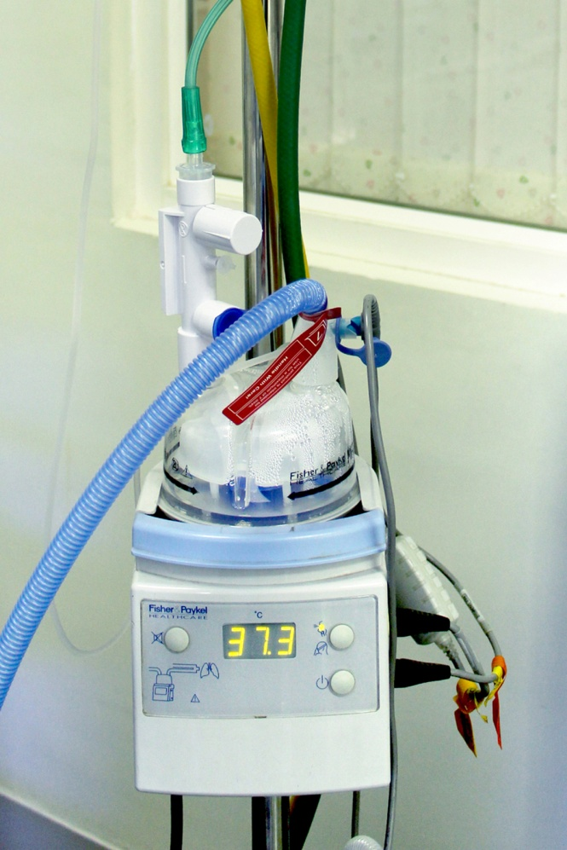
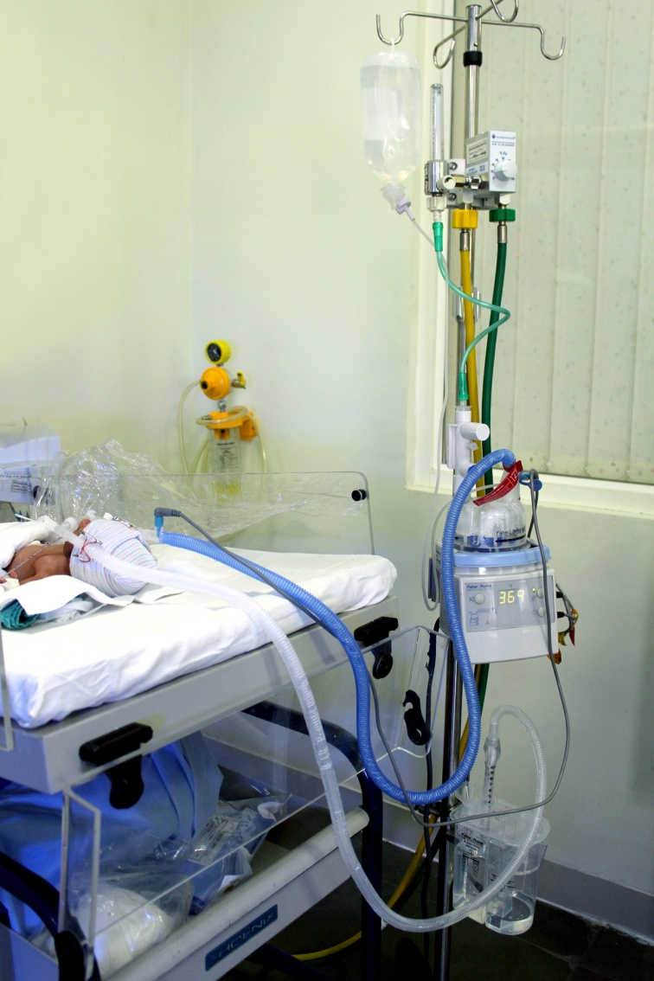
Humidifier
37º c
39º c
37º c
37º c

Slide 8
Types of CPAP Machines
Bubble CPAP Machine
Flow Driver CPAP Machine
Ventilator CPAP

Slide 9
Cleaning and Disinfection
Always use disposable circuits
No need to replace circuit routinely
Fill the Humidifier chamber with Distilled water
Use Auto-fill option for filling the chamber
Clean the equipment with a soft cloth
Humidification to avoid water logging

Slide 10
Troubleshoot
Alarm from the blender
Malfunctioning of Blender
Leaks in the circuit
Condensation in the inspiratory limb
No condensation in the expiratory limb
Inadvertent delivery of high pressures

Slide 11
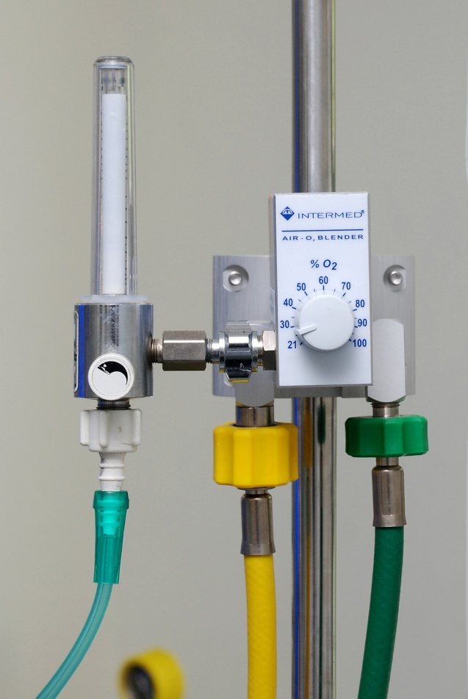

Troubleshoot
Blender
Leaks
Safety device

Slide 12
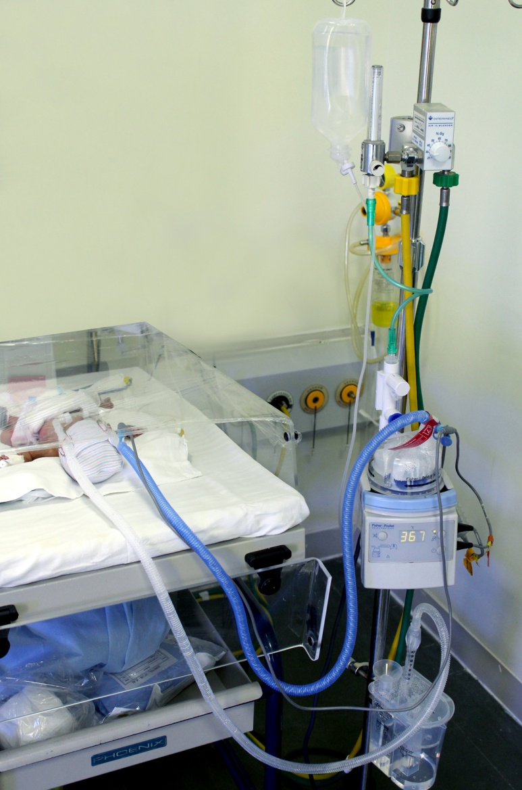
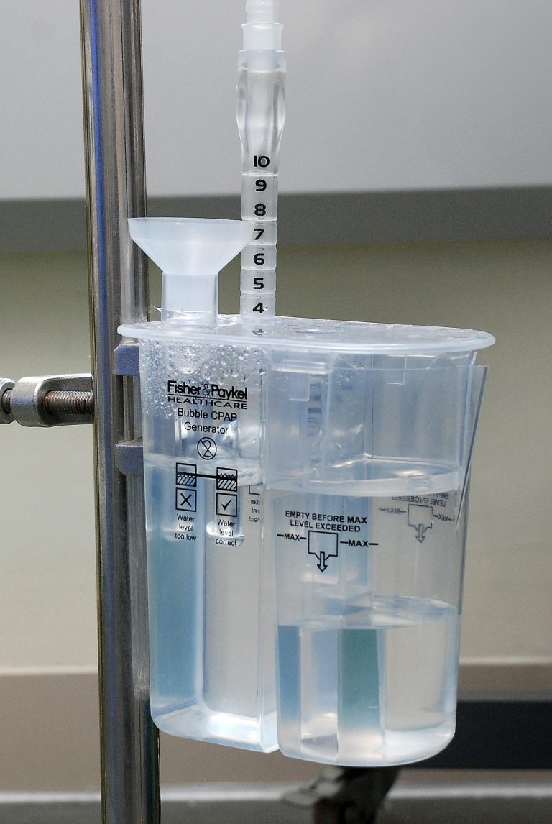
Condensation and Water

Slide 13
Summary
Basic Requirements | Pressure Generator Graded Oxygen Warmidification
Pressure | Bubble Generator
Oxygen | Blender Oxygen Compressed Air
Warmidificaiton | Servo Controlled Humidifier

